Slide 1

New Day, New data Team-06

Slide 2






Team members
Bhavya Deepthi
Rohitha Reddy
Ravichander Reddy
Alekya
Tarun
Sumanth

Slide 3
Introduction to Project
Our Project involves analysis of the Vehicle repair maintenance data collected from all over the United states.
The data set have a data related to repairs, corresponding departments handling them and the total cost involved for the repairs.
Data source: https://catalog.data.gov/dataset/vehicle-repairs
Domain of data set: Local Government- Vehicle Maintenance

Slide 4
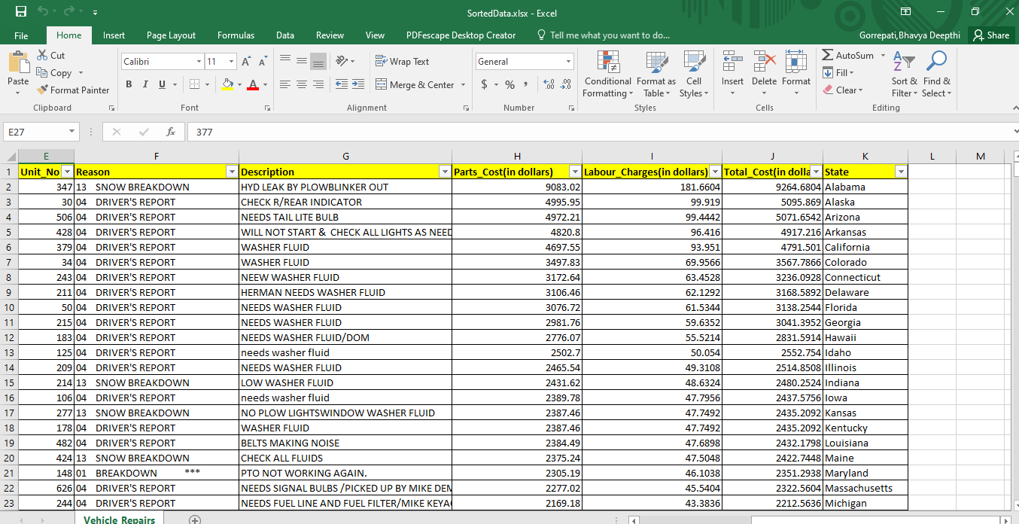
Data set Attributes
Vehicle repair original data set had irrelevant and duplicate data.
After applying cleaning strategies, the data set have the below columns.
Department_Id, Enrolled_date, Receipt_ID, Vehicle_ID, Unit_No, Reason, Description, Parts_cost, Labor Charges, Total_Cost(dollars), State
In total the data set have 500 records with 11 columns

Slide 5
Tools Used
To analyze the data set in our project, we have used the below two tools for visualization.
Tools Include:
Excel
Tableau

Slide 6
Goals
Which state has got registered with the highest repairs in the month of 'March 2015?‘
Compare the total repair costs earned through department ‘2111’ in all the states.
Compare the labor charges acquired during each month of the year 2015

Slide 7
Cont.…
Total cost earned by each department and count of common reasons they handle.
Map the states with the count of distinct departments and the sum of the total cost
Average profit gained through parts sale across all states in the month of 'January 2015'

Slide 8
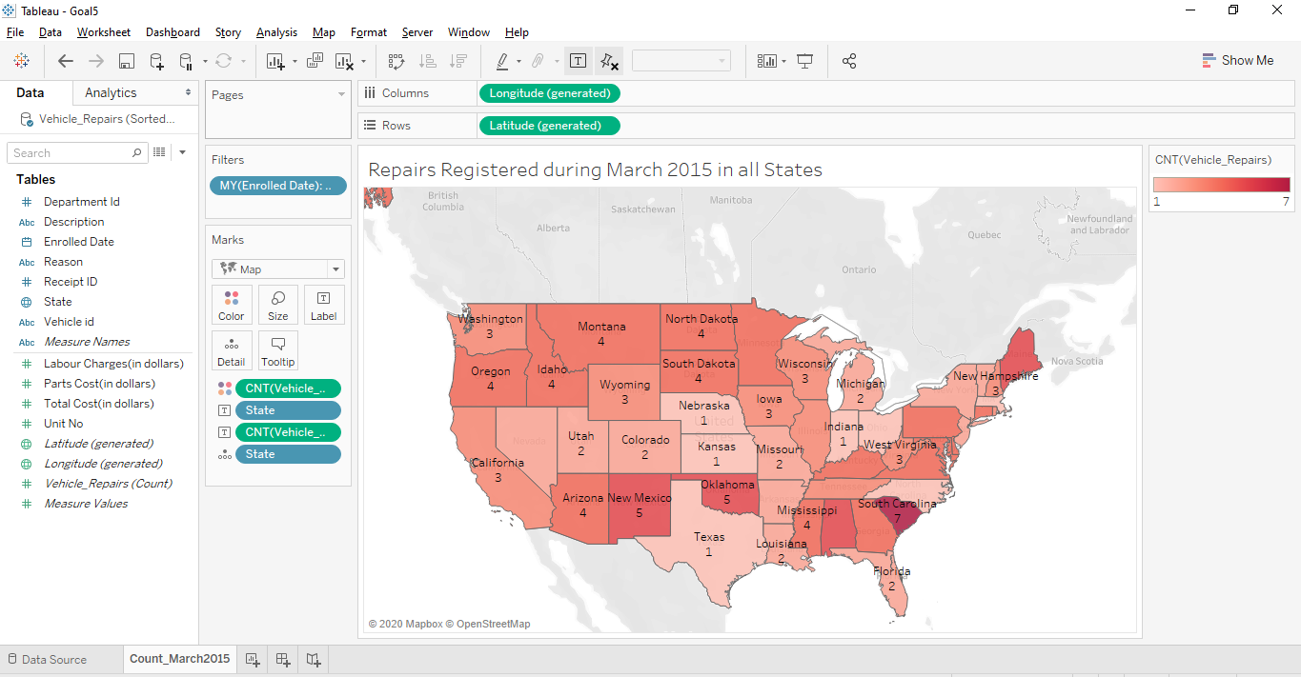
Goal-1
Which state has got registered with the highest repairs in the month of ‘March 2015’?
Choropleth

Slide 9
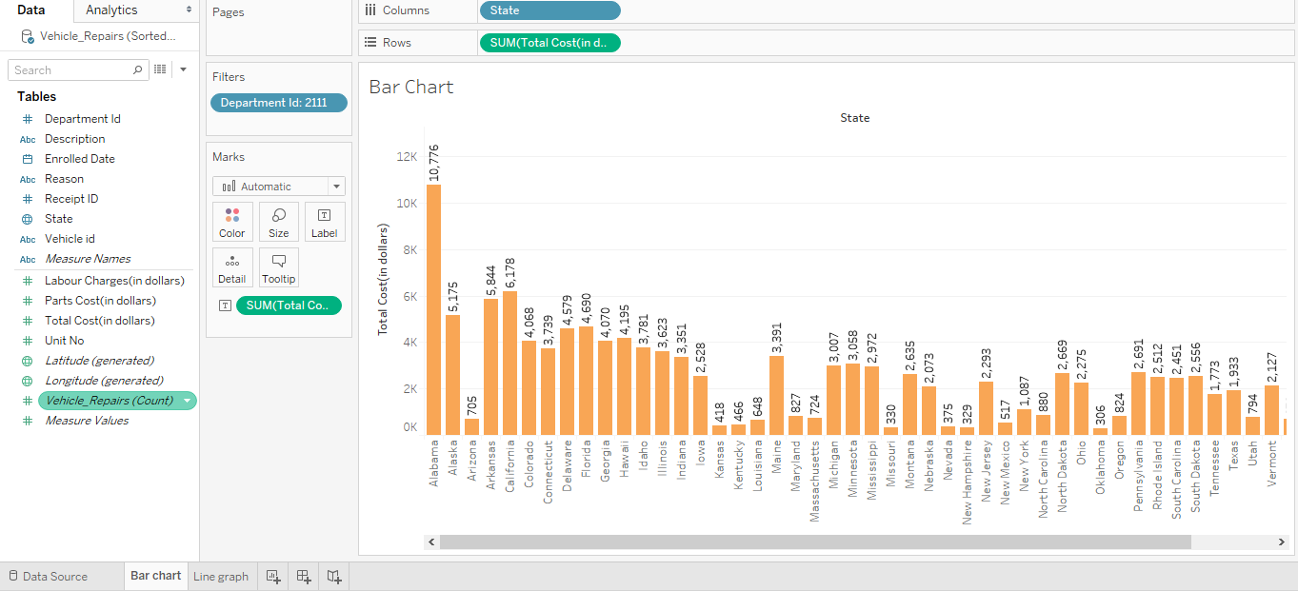
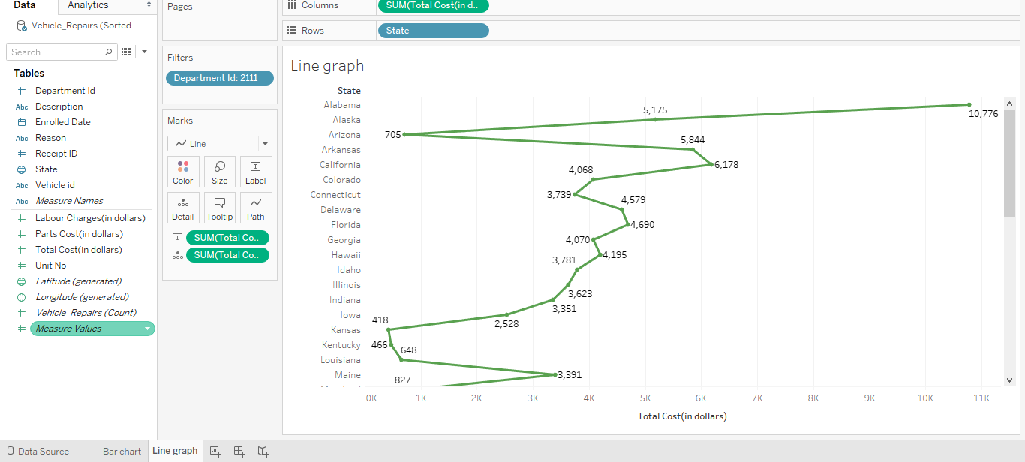
Goal-2
Compare the total repair costs earned through department ‘2111’ in all the states.
Bar Chart Line Graph

Slide 10
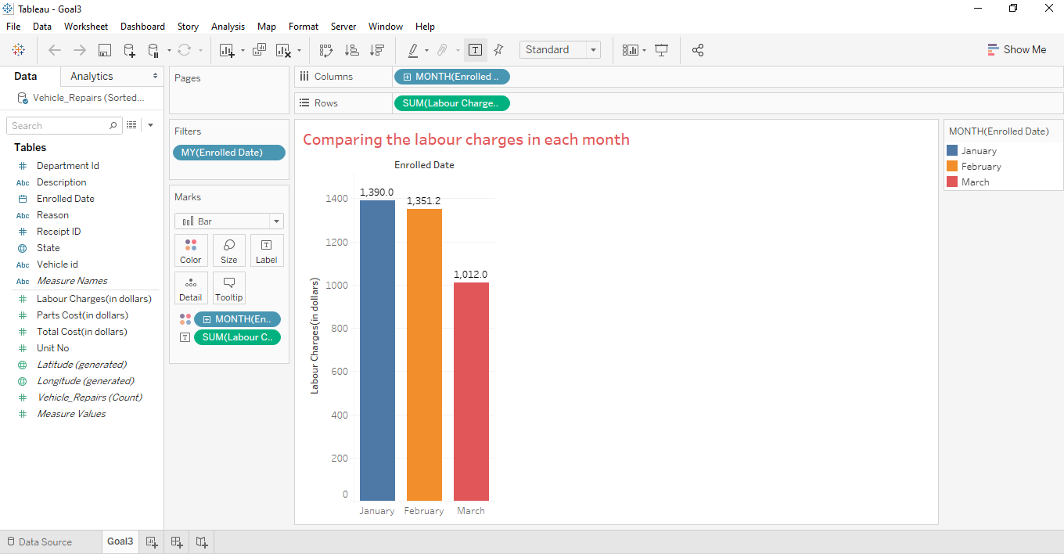
Goal-3
Compare the labor charges acquired during each month of the year 2015
Bar Chart

Slide 11
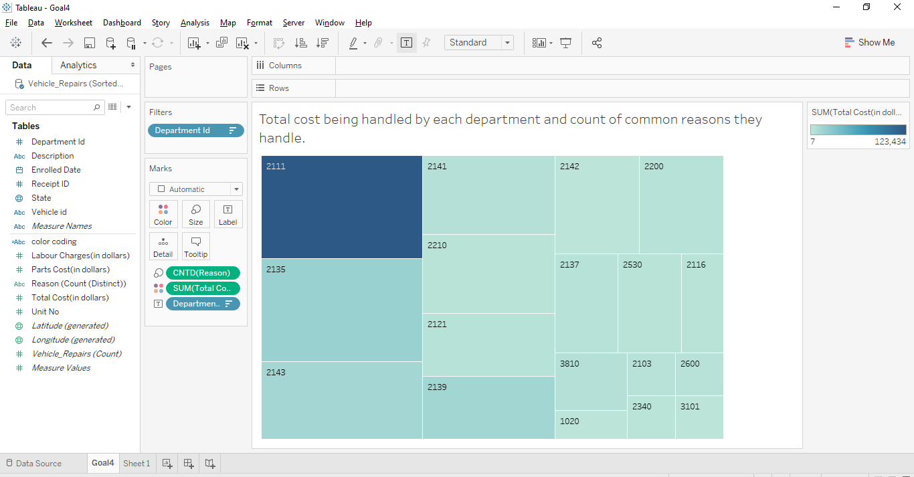
Goal-4
Total cost earned by each department and count of common reasons they handle.
Tree Map

Slide 12
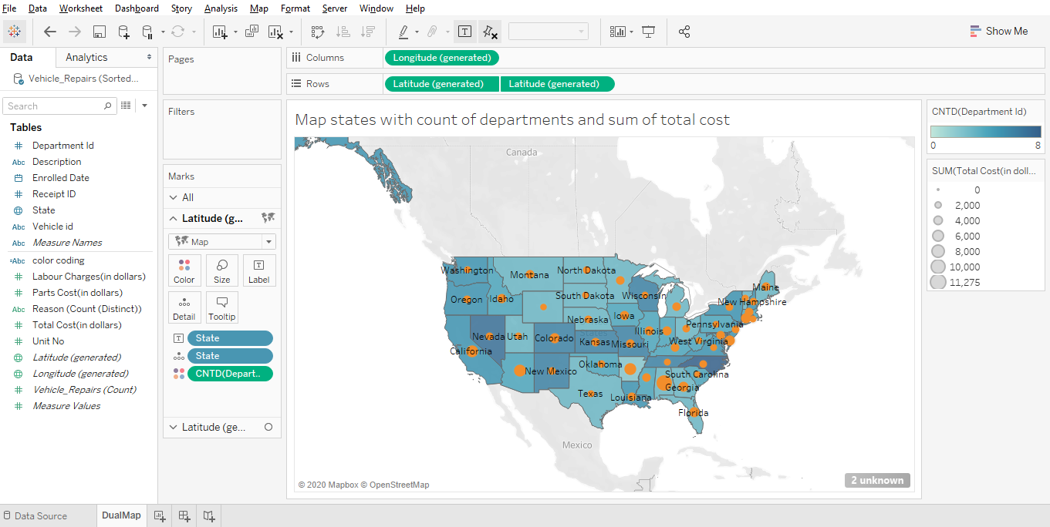
Goal-5
Map the states with the count of distinct departments and the sum of the total cost
Dual Layer Map

Slide 13
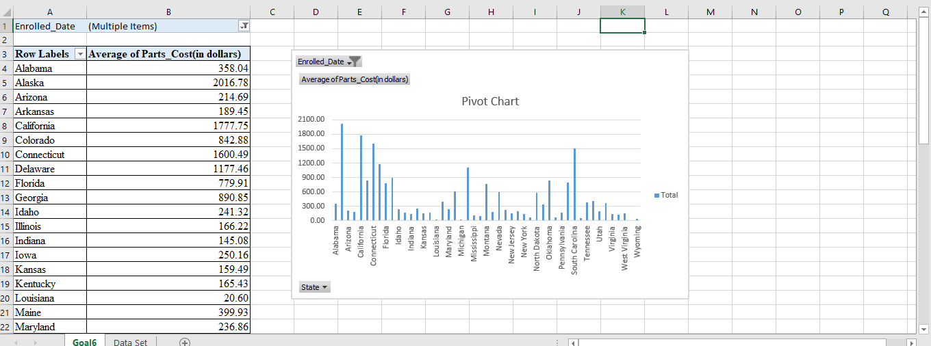
Goal-6
Average profit gained through parts sale across all states in the month of 'January 2015‘
Pivot Chart

Slide 14
Conclusion
From our analysis of data set through charts, it is clear that department ‘2111’ handles most of the vehicle repairs with high total cost.
Data visualization is the best way to analyze the bulk data in a better way.

Slide 15
Thank you

